Slide 1
Parallel Programming Project
Lorenzo Casalini,
September 2020.
Advanced Algorithm and Parallel Programming Course.
Politecnico di Milano

Slide 2
Scope of the project
Accelerating an application of molecular docking described in the paper «Tunable Approximations to Control Time-To-Solution in a HPC Molecular Docking Mini-APP».
The paper describes how to accelerate the maximization of the overlap score of a molecule and a ligand, exposing some software knobs.
The project is about to parallelize and accelerate the application described in the paper. The code is written in C and the technologies used for the acceleration are Cuda and OpenMp.

Slide 3
Molecular Docking
Molecular docking is the process of extimating the pose of a given molecule called ligand, when it interacts with a part of a bigger proitein called pocket.
It can be made in two ways: a geometric approach and a pharmacophoric approach. The application focuses on the geometric approach where no chemicals or fisical interaction between atoms are involved.
The geometric approach is used to filter the ligands that cannot geometrically fit into a pocket, so reducing the number of ligands to be checked with the pharmacophoric approach.
This process is called virtual screening.

Slide 4
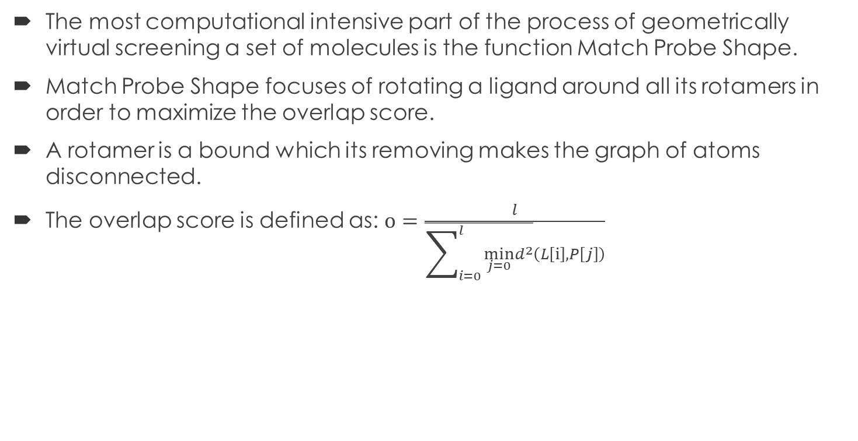
Virtual Screening and Match Probe Shape
The most computational intensive part of the process of geometrically virtual screening a set of molecules is the function Match Probe Shape.
Match Probe Shape focuses of rotating a ligand around all its rotamers in order to maximize the overlap score.
A rotamer is a bound which its removing makes the graph of atoms disconnected.
The overlap score is defined as: $o=\frac{l}{\overline{\sum_{i=0}^{l}{\min_{j=0}d^{2}}}\left(L\left[ⅈ\right],P\left[j\right]\right)}$

Slide 5
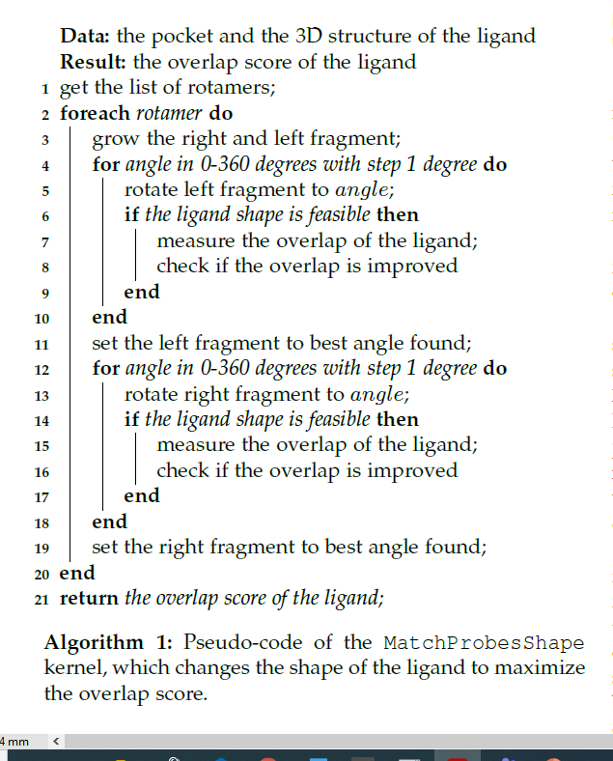
Match Probe Shape
The function first find all rotamers.
Then for each rotamers put the left and right fragment of the ligand in the angle with the best overlap.

Slide 6
Improving Match Probe Shape
The most expensive part of the function Match Probe Shape is the invocation to Measure Overlap. In the paper some considerations are made in order to find tecniques to reduce the number of calls to that function.
Small fragments have a smaller impact on the overlap score of a ligand.
Usually wider peaks contains the angle with bigger overlap.
Larger fragments usually has less peaks than smaller ones.
Smaller and larger fragments are usually more frequents.
A peak is the set of contiguous routation angles which overlap is bigger than 50% of delta, where delta is the difference between minimum and maximum overlap of a single rotation.

Slide 7
Software Knobs
In order to accelerate Match Probe Shape the paper describes tunable application knobs:
HIGH PRECISION STEP
LOW PRECISION STEP
TRESHOLD
REPETITIONS
ENABLE REFINIMENT

Slide 8
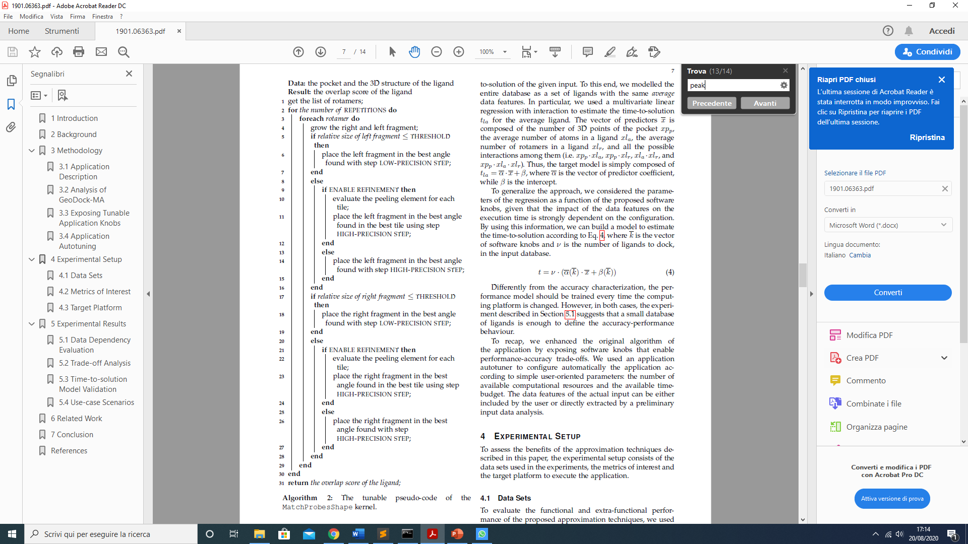
Improved Match Probe Shape
This time all the function is repeted REPETITIONS time.
If a fragment is < THRESHOLD put it in the best angle using LOW PRECISION STEP
Else if ENABLE REFINIMENT we divide the 360° angle in tiles and for each tile we evaluate the middle element, then we place the fragment in the best angle of the best tile using HIGH PRECISION STEP
If ENABLE REFINIMENT is false we simply put the fragment in the best angle using HIGH PRECISION STEP.

Slide 9
Hardware and Software used
All the different version of the application are tested in Windows 10 using the nvcc compiler. The non parallel version is also tested in Linux with gcc compiler using a virtual machine.
GPU used: Nvdia GTX 1650 super (4 Gb, 1280 Cuda Cores)
CPU used: AMD Ryzen 7 3700 X (8 Cores, 16 Threads)

Slide 10
Implementation of Match Probe Shape
The first step I did to execute the project is to implement a serial version of Match Probe Shape in C.
The serial implementation is in the file kernel_np.cu in the GitHub repo.
As cost function, I didn’t use the overlap function but, as suggested, I used the sum of the distances between the atoms of the molecule.
I considered a ligand feasible when each atom is at least at 0.8 A° from all the other atoms.
I assumed each molecule to be in a separate file mol2.
In the main function the program reads a list of names of molecules and then uses a tokenizer to fill a struct called molecola.

Slide 11
Implementation of Match Probe Shape 2
To represent a molecule in memory I used a struct called molecola which stores the name, the number of atoms, the number of bonds, the 3D positions of the atoms and the bounds.
The position of the atoms and the bounds are list respectively of double and int of fixed length (they are enough long not to overflow when a molecule is read).
The rotamers are found using a breadht-first-search in the bonds graph:
For each bond I take the left and the right atom
I do a bfs rooted at each atom (deleting the considered bond), using a queue where I store the element that I find do far.
If the queues have different atoms and the size of the queue is bigger than one, the bond is a rotamer.

Slide 12
Implementation of Match Probe Shape 3
For each rotamer I did what is described in the paper so I rotate the left and the right fragment depending on the knobs.
The rotation of a fragment around an axis (the rotamer) is taken from: http://www.eng.uc.edu/~beaucag/Classes/Properties/OptionalProjects/CoordinateTransformationCode/Rotate%20about%20an%20arbitrary%20axis%20(3%20dimensions).html.

Slide 13
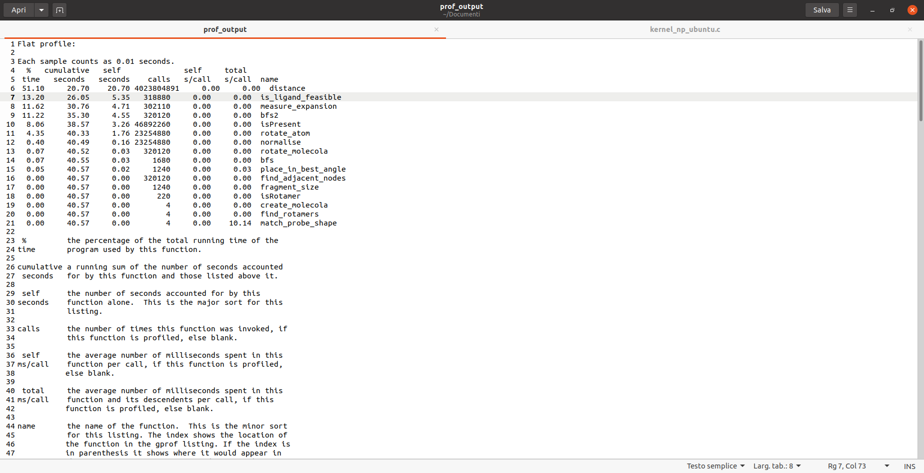
Profiling
I profiled the serial version of the application using gpof in a Ubuntu virtual machine. I tested it with four molecules.
The test are done with REPETITIONS =10, LOW PRECISION STEP = 30, HIGH PRECISION STEP = 1, ENABLE REFINIMENT = false, THRESHOLD = 0.2.
As expected the most expensive part is calculating the distances between an atom and all the other, followed by the feasibility check of the molecule.
The running time of the serial application, runned on the real machine using all 48 molecules I have is of 337 s.

Slide 14
Testing
I have no way to know if the expansions that the application finds are the correct ones but I found that it behaves every time as expected.
First of all I used Valgrind to find some memory leaks in the code.
Then I used some indicator of correcteness of my code:
The expansion of the molecule after match_probe_shape is always bigger than before.
Changing the software knobs changes the expansion as expected.
Molecules with more atoms have bigger expansions.
Time used by the application for run in a smaller molecule is less than a bigger one.
The rotamers found are true rotamers.
Every run of the code with the same knobs has the same result, either serial or parallel.

Slide 15
Parallelization: measure expansion
As suggested by the profiling made on the serial implementation the first thing I did is parallelize the measure expansion function.
The strategy is that every Cuda thread of the kernel calculates the distances from an atom (which corresponds to its thread_id) to all the other atoms.
I tried two different ways of doing memory management for this kernel:
Using a helper function that mallocs (cudaMallocManaged) in the unified memory a array of distances, each threads fills the corrisponding element, and then the helper function sums all the elements.
Inizialize the vector of distances on the device shared memory, every threads write in it and only one thread, after all the other threads have finished the calculations (__synchtreads), sums all the distances. This approach doesn’t allow me to use more than one block since shared memory is common for threads in the same block.

Slide 16
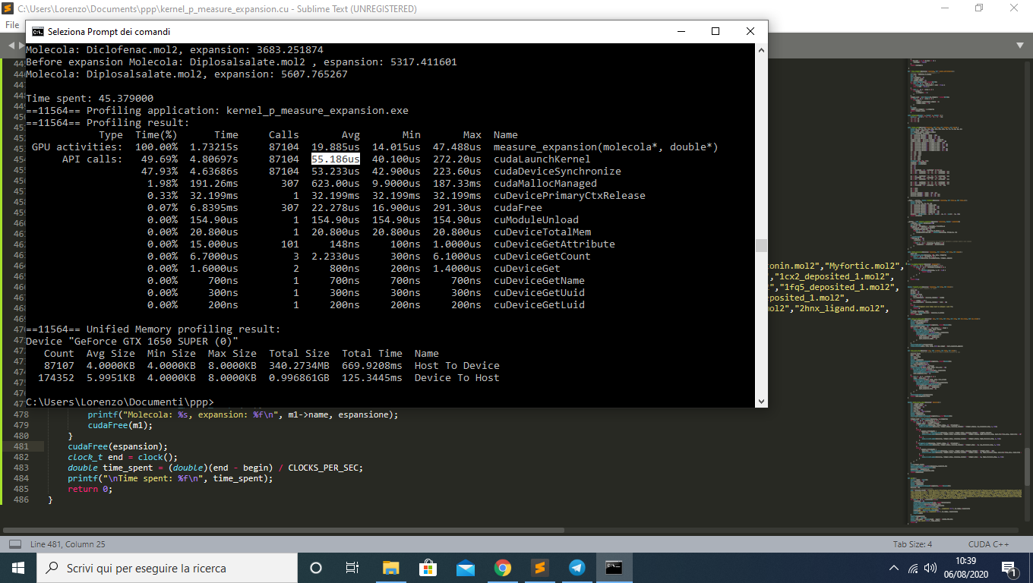
Performances
I profiled the application using nvprof.
In this case the time spent for running the application on three molecules is far worst than the serial case.
From the profiler I can see that the time spent to launch and synchronize kernel are too much, so I can conclude that that this function is called too many times and it is too lightweight to have an effective speedup parallelizing it.
This is the version with the vector of distances saved in the shared memory.
This kernel is called kernel_p_measure_expansion.cu in the github repo.

Slide 17
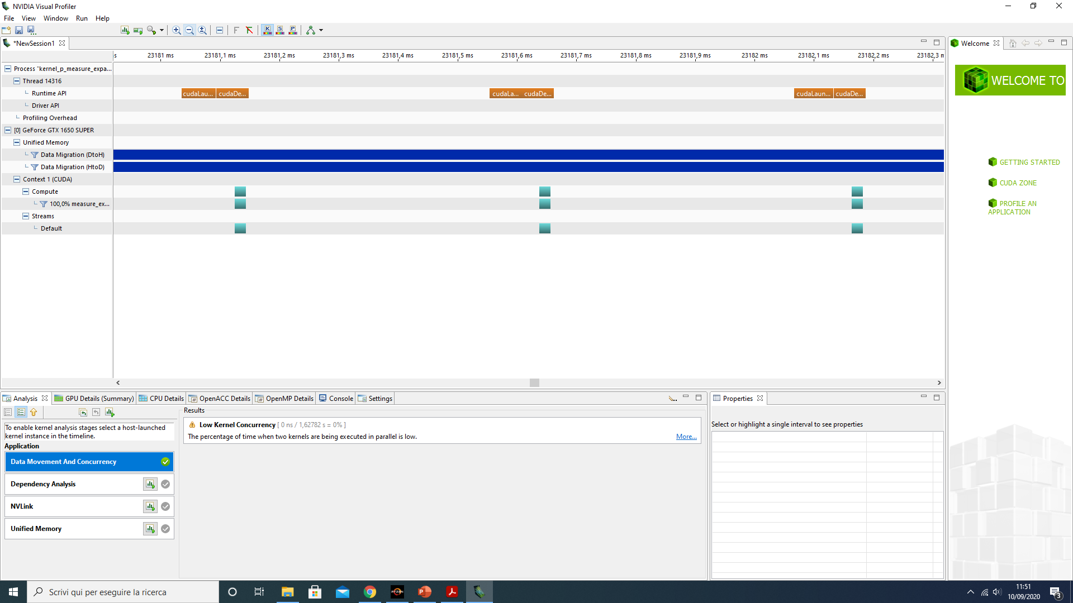
Visual Profiling

Slide 18
Rotate Molecola
I tried to parallelize the function rotate_molecola.
Every time I need to ratate a fragment I use a kernel in which every thread rotates a single atom around the selected rotamer.
As before I tried two different strategies to manage memory:
Used a helper function which do a cudaMallocManaged to put a struct queue (which is needed to find the adjacent nodes of a rotamer part) and, after the parallel kernel is done, synchronizes and frees the memory.
Put the queue in the shared memory, only one thread searches for adjacent nodes, and after a synchronization all the threads rotates the corresponding atom.
Those applications are called kernel_p_rotate_molecola.cu and kernel_p_rotate_molecola_2.cu

Slide 19
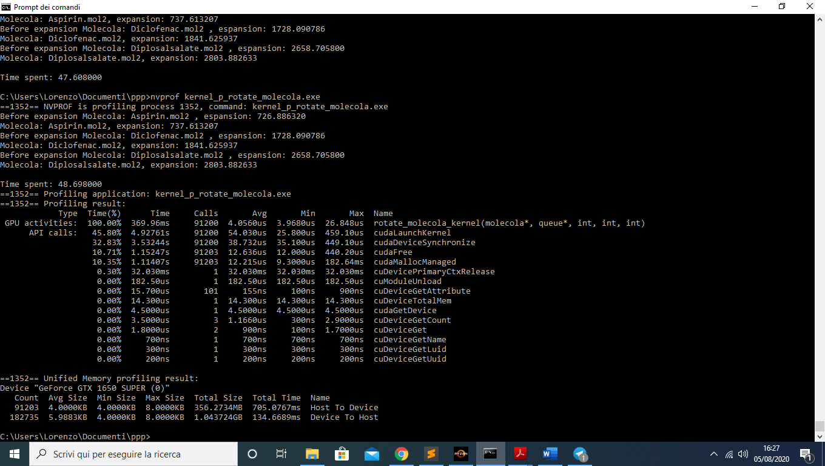
Performance
This is the first version described before.
We can see that, as before, the overhead given by kernel creation and synchronization is too big and the application perform worst than the serial one.

Slide 20
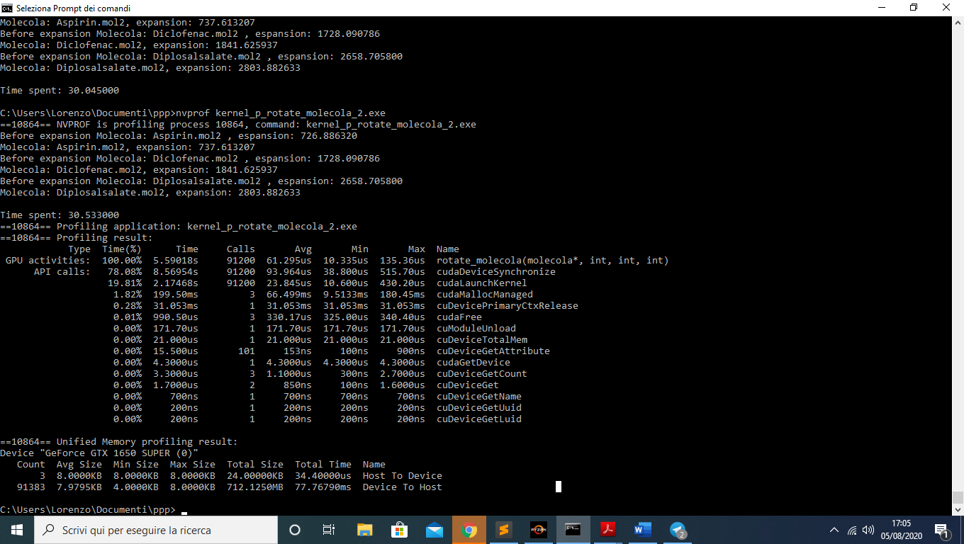
Performance 2
Here the performances are better than the case discussed before, but they are still much worse than the serial case.
As expected I can note an improvement in the phase of memory managing.

Slide 21
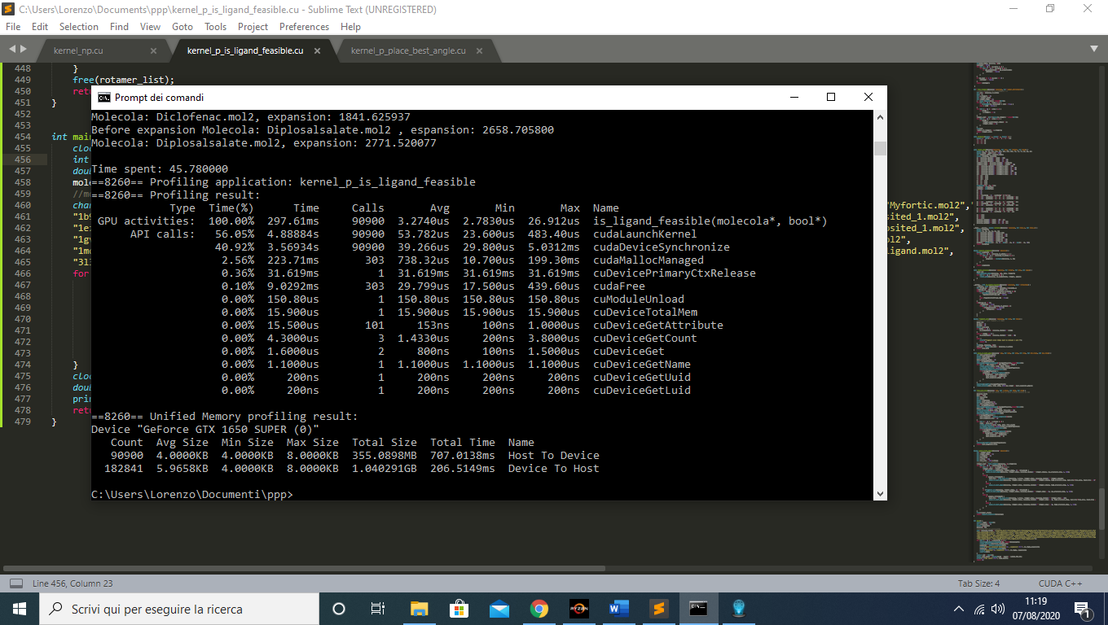
Is ligand Feasible
The last effort I did to parallelize the application at low level was creating a kernel to do feasibility check after a rotation in parallel.
Each thread takes an atom and checks that all the other atoms are at distance > 0.8 A°.
As expected the kernel is called too many times and the overhead for synchronization and launching is too big.

Slide 22
Place Best Angle
The next step was trying to parallelize the application at higher level to see if I can achieve better results.
I parallelize the function place_best_angle. This function is the one that, given a fragment, rotate it in all the angles, measures the expansion and at the end place the fragment in the angle in which it guarantees the bigger espansion.
Each Cuda thread makes a copy of the molecule (which is allocated in the global memory) in its local memory, rotates it in the angle corresponding to its thread_id, checks the feasibility of the new pose and measures the expansion of the molecule in the new pose.
The expansions of all the angle examined are saved in a array in the global memory and it is up to the host to find the best expansion and to rotate the original molecule.

Slide 23
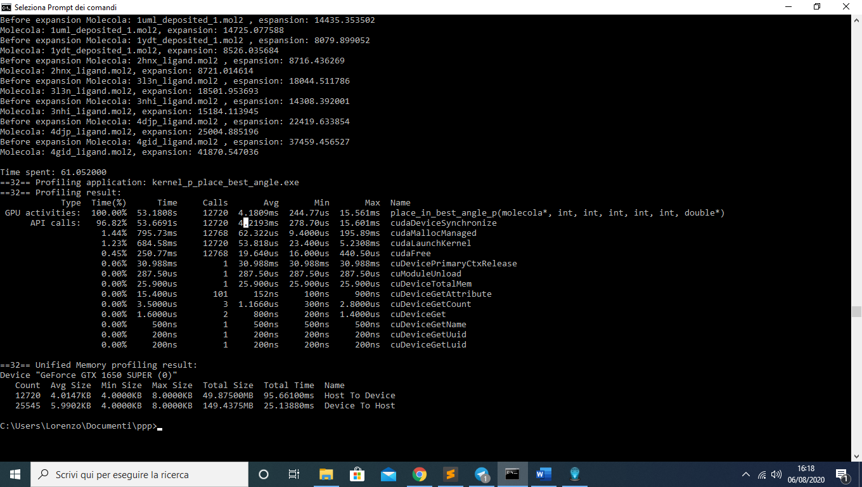
Performance
This are the results of profiling the application using all the 48 molecules I have.
The performance is better than the serial case: 61s vs 337s.
From the result of profiling I can see that the most of the time is spent by the place_in_best_angle kernel.
The overhead given by memory management is negligible in this case (< 1s).
This time the kernel is not called so often as in the provious cases so the overhead of launching kernel has smaller impact on the running time.
I can see that the most expensive API call is cudaDeviceSynchronize which waits every time place_in_best_angle_to_complete.

Slide 24
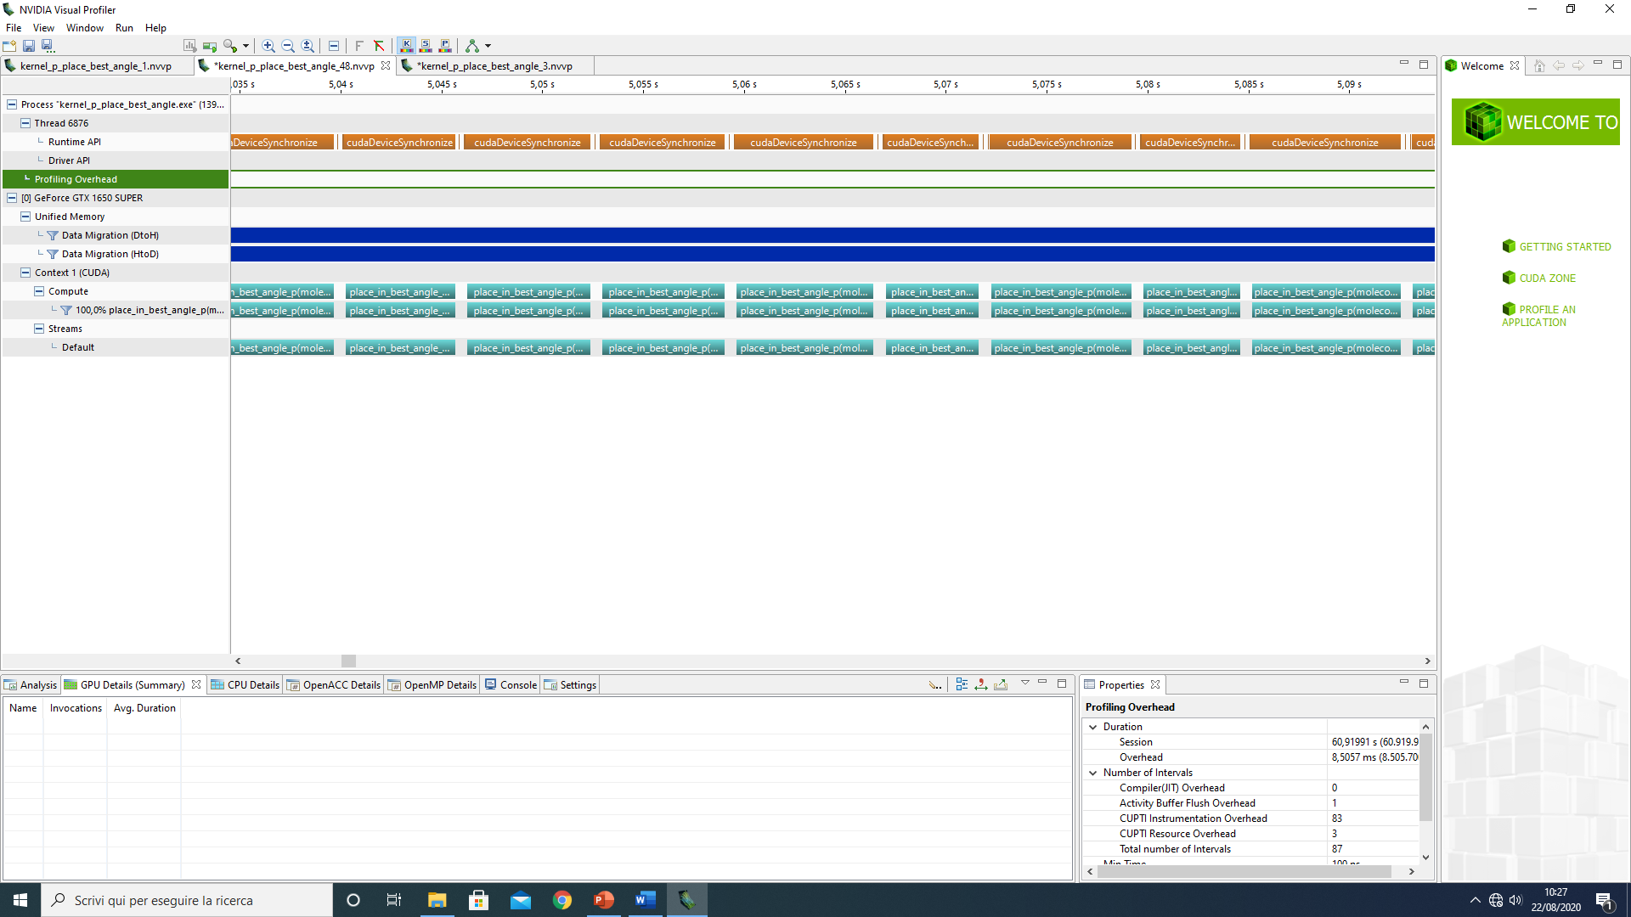
Visual profiling

Slide 25
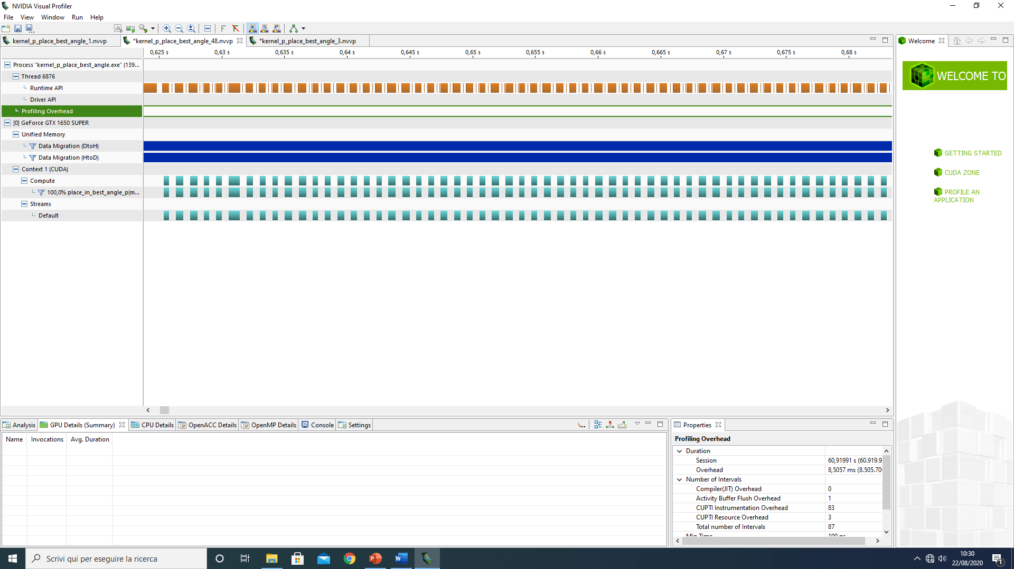

Slide 26
Analysis of visual profiling
The previous slides present the result of visual profiling the application using Nvidia Visual Profiler.
They are two screenshots taken at the different moment with the same scale time, in the first screenshot the application is docking a big molecule (>100 atoms), in the second a small one (<50).
Can be seen how the bigger molecule has longer kernel with less idle time between two consecutive kernels.
This is very good because means that is easier to have more parallelism managing bigger molecules, which are the slowest one.
As seen in nvprof the time spent by the application in the API calls is small. The only API call that is very long is CudaDeviceSynchronize but it is expected because it has to wait the termination of the kernel.
The blue lines in the data migration rows means that, in that segment of time, the data migrations take less tha 10% of the time.

Slide 27
Further improvement
I wasn’t able to reduce properly the idle time between two kernel launch because I needed immediatly the results of the kernel, so it was impossible to me to use some independent instruction between the line I launch the kernel and the line I synchronize.
I found that the best way to launch the kernel is with 12 blocks of 32 threads. In this way the time spent is 51s.
I tried to asynchronously prefetch memory but the running time doesn’t change.

Slide 28
OpenMP integration
The last step was to exploit the embarassingly parallel nature of the problem. Each molecule is independent from the other so match_probe_shape can be executed in more than one molecule in parallel.
The idea is the following:
In the main function the loop that feeds match probe shape with the molecules is parallelized using #omp parallel for.
Each OMP thread creates a Cuda Stream, mallocs the memory of a molecola, attaches the memory to the stream via CudaStreamAttachMemAsync and then calls match_probe_shape where there is the Cuda kernel place_in_best_angle.
The only difference between the kernel described in the previous slides and this one is the stream management, i must use CudaStreamSynchronize and, as described before, CudaStreamAttachMemAsync.
I want to call some OMP threads, each one creating a Cuda Stream which execute the application concurrently to all the others.

Slide 29
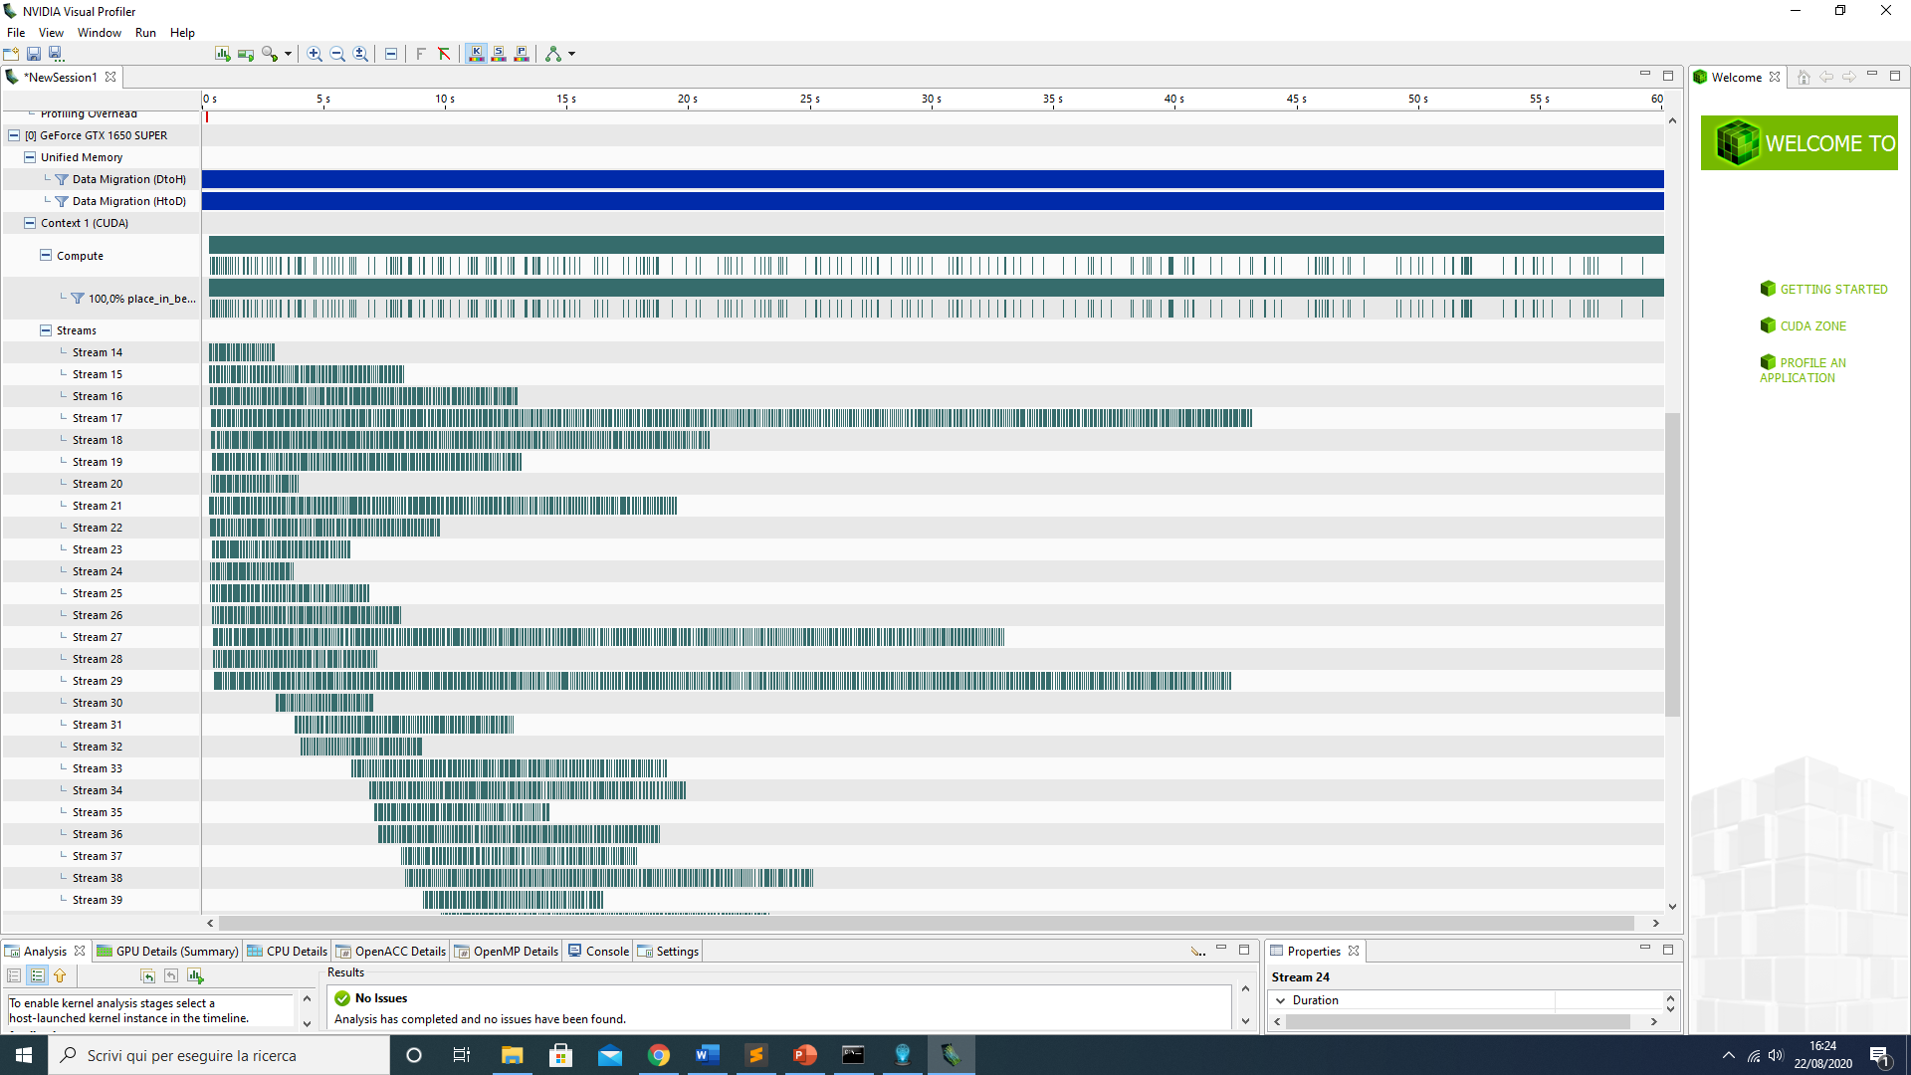
Result of visual profiling the application
The green bars are the Cuda Streams running concurrently.

Slide 30
Performance
The application written in Cuda + OpenMp runs in 47.5s, which is 3.5 seconds better than the Cuda version.
I expected a better improvement but the visual profiler indicates me that only the 10% of the operations are run concurrently. This probably happens due to the limitations of my hardware.
Using a software to calculate the occupancy on my GPU I found that during the execution the load was of 95%, so probably there are no cores free to execute new kernels.

Slide 31
Thank you for your attention

